Slide 1
6 Month Allelic Series RNAseq QC

Slide 2
QC summary
QC was performed on all 192 samples focusing on determining failed or outlier
samples. Four samples are recommended for omission from the final analysis
dataset based on evidence of RNA degradation, PCA analysis, and model-based
gene outlier detection. Those four samples can be found on slide 19.
Additionally two correctable issues were identified. First, one flowcell worth of
samples was run an additional time to add read depth to the 100 million required.
This re-run was inadvertently run as 75-mers instead of 50-mer so the samples
are a mix of read length. Secondly, for a subset of cortex samples (Q92 and Q140)
there appears to be an infinitesimal but detectable amount of liver tissue. The
overall dilution is 500-1000x, but given the extraordinary sensitivity of RNAseq this
is still measureable. We have recommended a simple filter to remove those liver
transcripts based on the fact that they have a recognizable correlation pattern
(listed on slide 29), but other methods may be more sensitive.

Slide 3
How does CHDI QC RNAseq data in general?
Mostly we’re looking for outliers
Also showing overall experiment worked
When we find outliers, we try to determine the cause
  That helps show it is an outlier and not part of the biology
Methods
  Principal Components Analysis
  RNA degradation plots
  Paired end insert size
  Read lengths
  Read mapping efficiency
  Repetitive sequences and their origin
  Highly expressed genes
  # gene outliers

Slide 4
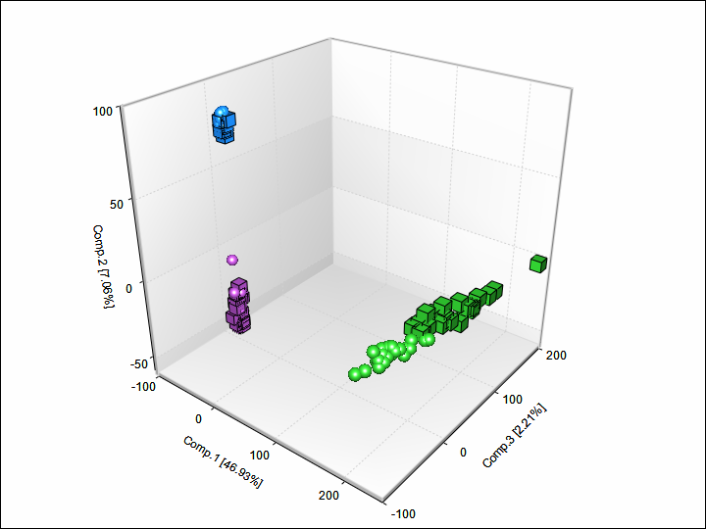
PCA whole dataset
Not surprisingly, tissues
cluster
Strong sex effect in liver
Cortex is tightly clustered

Slide 5
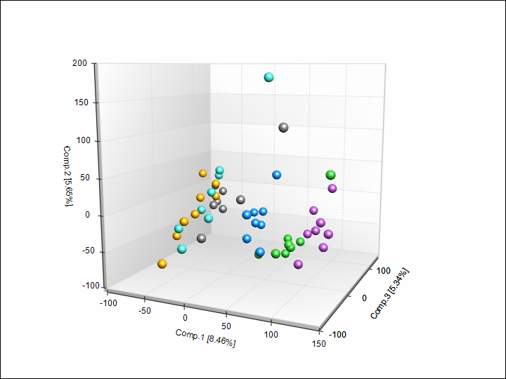
PCA striatum
30811_718L_striatum_Q80_HET_F_L5.LB14_1.clipped
35481_833L_striatum_Q92_HET_M_L3.LB10_1.clipped
Q lengths cluster, good sign
the design worked
Q92, 111, 140, 175 uniquely
cluster
They even stagger in
Q length order
Couple potential outliers
(in red outline)

Slide 6
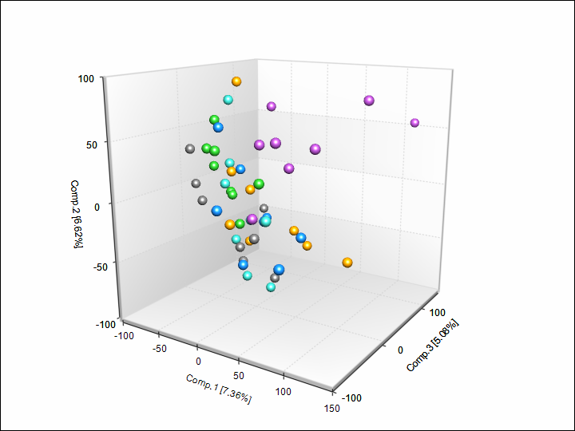
PCA cortex
21051_460L_cortex_Q175_HET_F_L3.LB6_1.clipped
20947_452L_cortex_Q175_HET_M_L8.LB2_1.clipped
Only Q175 stands outside
the main cluster
Possible Q175 outliers,
but hard to be certain

Slide 7
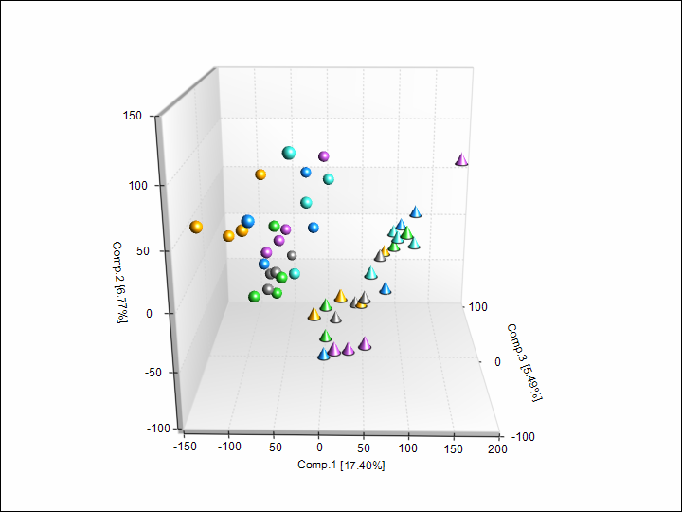
PCA liver
450_Liver_Q175_HET_M_L8.LB1_1.clipped
Strong sex clustering will
need to be accounted for
No strong Q clusters
(sex masking?)
One potential outlier

Slide 8
Duplication in brain (representative examples)
Duplication is consistent and
hovers between 13-24%
No red flags
Higher in striatum than
cortex generally
Origin of the majority of the
duplicated sequences is
mitochondrial

Slide 9
Liver duplication (representative examples)
Liver duplication is much higher, 40-50%
Major duplicated sequences are all mouse pheromone receptors (Mup1-21)
Hurts our true read depth, but nothing terrible
Should keep in mind for future liver work

Slide 10
5’ -> 3’ degradation charts (representative examples)
Displays the likelihood of getting
full length transcripts for various
mRNA lengths
Very high quality samples in general
Most samples show >70% of all mRNA
molecules are >80% complete
Liver on average more degraded
Some samples have degradation in the
longer mRNA species (one marked in red)

Slide 11
Suspect samples by 5’ -> 3’ degradation
454_Liver_Q175_HET_M_L3._1.clipped
456_Liver_Q175_HET_M_L7.LB4_1.clipped
20947_452L_cortex_Q175_HET_M_L8.LB2_1.clipped
845_Liver_Q92_HET_F_L6.LB25_1.clipped
522_Liver_Q111_HET_F_L8.LB13_1.clipped
452_Liver_Q175_HET_M_L1.LB2_1.clipped
776_Liver_Q140_HET_F_L8.LB13_1.clipped
716_Liver_Q80_HET_F_L7.LB6_1.clipped
843_Liver_Q92_HET_F_L6.LB23_1.clipped
21051_460L_cortex_Q175_HET_F_L3.LB6_1.clipped

Slide 12
GC content per read has a red flag
8 of the samples have a “shoulder”
in the GC# chart
This is usually a really bad thing
Suggests non-mouse or
non-biological sequence

Slide 13
Those same samples flag for read length as well
Those same samples have a mix
of 50mer reads and 75mer reads
That’s very odd
At this point we asked our sequencing
lab for clarification on what happened

Slide 14
Our sequencing partner found the cause
The 8 suspect samples
264401 | 20921_1_450L_cortex_Q175_HET_M | 20130523 | V02604 | VIRT | 2
264416 | 23535_1_528L_cortex_Q111_HET_F | 20130523 | V02604 | VIRT | 3
264418 | 28243_1_644L_cortex_Q20_HET_M | 20130523 | V02604 | VIRT | 4
264397 | 35624_1_844L_striatum_Q92_WT_F | 20130523 | V02604 | VIRT | 1
264447 | 35631_1_845L_cortex_Q92_HET_F | 20130604 | V02761 | VIRT | 1
264448 | 35657_1_847L_cortex_Q92_HET_F | 20130604 | V02761 | VIRT | 2
264451 | 454_Liver_Q175_HET_M | 20130604 | V02761 | VIRT | 3
264455 | 462_Liver_Q175_HET_F | 20130604 | V02761 | VIRT | 4
For these 8 samples, the initial run didn’t get a full 100 million reads. When that happens the lab runs the samples again and then merges the run into a full “virtual run” of the full read depth we paid for. That’s all good. The strange thing that happened to us this time was that the run they added our 8 samples to (they add it to ongoing flow cells) happened to be a 75mer run. Again no big problem usually, and what they do is clip off 25 bases in their processing and all is compatible. This specific time they forgot to trim, so we saw the ugly intermediate state.
What this means is that the data for those 8 are fine. They are longer, but still good reads from our samples.

Slide 15
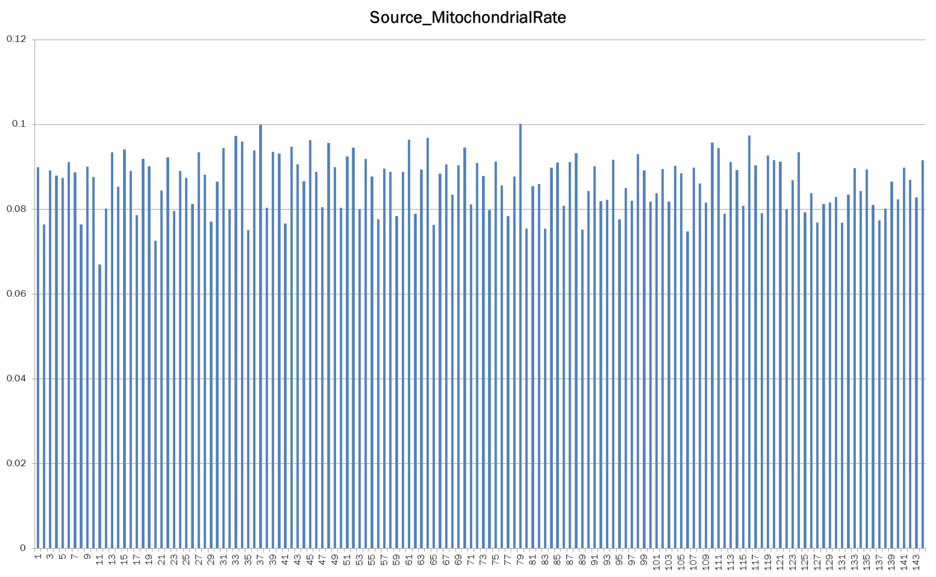
Mitochondrial rate in brain
8-9% of the reads are mtRNA
nothing surprising there

Slide 16
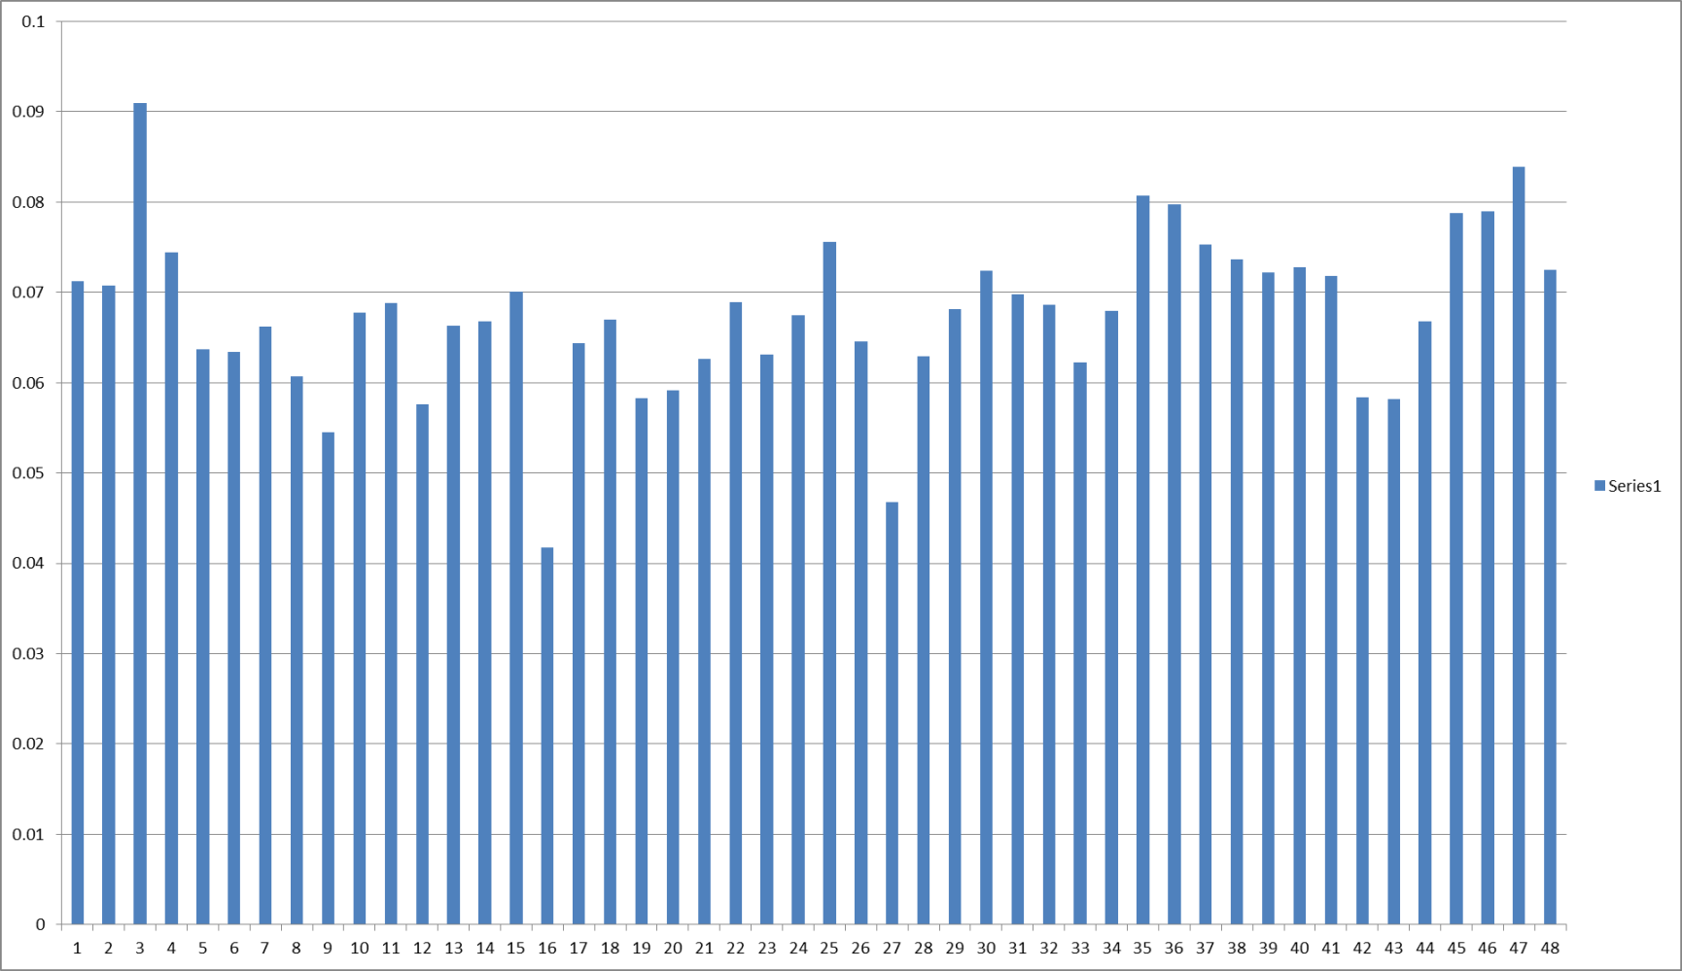
Mitochondrial rate in liver
6-7% of reads are mtRNA
Again in line with expectations

Slide 17
Other QC parameters that looked great
Insert sizes: All right around 175 as expected
Sense/antisense sequence ratio: 1:1 as expected
Sequence coverage
  40% of mouse transcriptome detected in brain
  About 30% of mouse transcriptome detected in liver
Mapped read rate in the upper 90s
  98% for brain, 96% for liver
95-97% of our reads are mapped to known genes
  3-5% intergenic regions

Slide 18
Model based outlier detection
Method by which we look for the number of genes that are
outliers after accounting for our modeled effects
2 samples stand out, and additional 4-6 are suspect, but probably
OK (Q92 Het males)
30811_718L_striatum_Q80_HET_F_L5.LB14_1.clipped
35481_833L_striatum_Q92_HET_M_L3.LB10_1.clipped

Slide 19
Integrating the sample QC to choose omissions
A very simple way to determine what to throw out
is to look for multiple strikes against a sample
5’ -> 3’ charts
PCA outliers
Model based outliers
454_Liver_Q175_HET_M_L3._1.clipped
456_Liver_Q175_HET_M_L7.LB4_1.clipped
20947_452L_cortex_Q175_HET_M_L8.LB2_1.clipped
845_Liver_Q92_HET_F_L6.LB25_1.clipped
522_Liver_Q111_HET_F_L8.LB13_1.clipped
452_Liver_Q175_HET_M_L1.LB2_1.clipped
776_Liver_Q140_HET_F_L8.LB13_1.clipped
716_Liver_Q80_HET_F_L7.LB6_1.clipped
843_Liver_Q92_HET_F_L6.LB23_1.clipped
21051_460L_cortex_Q175_HET_F_L3.LB6_1.clipped
30811_718L_striatum_Q80_HET_F_L5.LB14_1.clipped
30811_718L_striatum_Q80_HET_F_L5.LB14_1.clipped
20947_452L_cortex_Q175_HET_M_L8.LB2_1.clipped
35481_833L_striatum_Q92_HET_M_L3.LB10_1.clipped
35481_833L_striatum_Q92_HET_M_L3.LB10_1.clipped
21051_460L_cortex_Q175_HET_F_L3.LB6_1.clipped
450_Liver_Q175_HET_M_L8.LB1_1.clipped

Slide 20
Final list of proposed samples for omission
30811_718L_striatum_Q80_HET_F_L5.LB14_1.clipped
20947_452L_cortex_Q175_HET_M_L8.LB2_1.clipped
35481_833L_striatum_Q92_HET_M_L3.LB10_1.clipped
21051_460L_cortex_Q175_HET_F_L3.LB6_1.clipped

Slide 21
Liver contamination in cortex Q140 and Q92?
While the sequencing lab was looking into the 75mer issue I ran cortex through some basic statistical modeling (omitting the samples mentioned previously)
I found changes, but the pattern and biology was all wrong

Slide 22
Every single change is an increase
Completely off in Q175, 111, 80, and 20
On (but not that strongly in 140 and 92)
It’s make no sense for Q111 to be skipped
and for Q175 to go back to normal
Logged FPKM
Albumin is the top hit?
Isn’t Albumin liver specific?

Slide 23
Some of the other changed genes are suspicious
Albumin
ApoC3, C1,
Mup3, 10, 18, 19
FABP1
Urate oxidase
All reasonably solid liver markers
DAVID functional annotation also suggests the altered genes
are liver related (p < 10⁻⁵)

Slide 24
A subset of genes with good correlation between liver and cortex
but shifted from the 1:1 axis

Slide 25
Same chart with the “significant” genes in red

Slide 26
Same chart and shading in Q111, notice the
Lack of linear correlation

Slide 27
What we suspect happened
The basic problem is that liver specific transcripts should not have correlated expression in cortex
A very small amount of liver contamination has occurred. The shift is 500 to 1000 times lower than normal liver expression
What this means is only the absolute highest liver expressed genes are detected at all
The challenge is uniquely identifying the affected genes
FPKMs of albumin, which should not exist in brain
 | Cortex | Striatum | Liver
Albumin | 173 | 0.01 | 40979

Slide 28
Liver filter created as
Liver mean count > 2000
Mean ratio of liver to cortex > 500
Cortex count > 0
Not a bad first approximation

Slide 29
Effect of filtering out the liver specific genes from the cortex data

Slide 30
Summary of QC
All but 4 of the 192 samples can move forward to the analysis
A filter to clear out highly expressed liver genes is needed for the cortex Q140 and Q92 sets
Striatum PCA plots show that CAG length is the single largest global element of variance!

